Slide 1


Predicting Employee Attrition
Capstone Project by-
Akhila sri Medarametla

Slide 2
Introduction
In business, employee attrition is when employees leave the company for whatever reason, either they've found a new job or retired, and haven't been replaced immediately.
For a company to be successful, it needs not only to attract top talent but also needs to retain these talents. For this, I took a dataset regarding a certain company's employee list to try to find patterns that may provide useful information in understanding why employees leave.

Slide 3

Chapter-1 1.1 objective and scope of the study
the objective of this project is to predict the attrition rate for each employee to find out who's more likely to leave the organization
it will help the organization to find ways to prevent attrition
attrition is not only a time-consuming and costly problem for the company but also leads to a loss of productivity

Slide 4
1.2 analytical approach
Check
Check for missing values in the data, and if any, will process the data accordingly.
Understand
Understand how the features are related to our main variable
Apply
Apply feature selection and feature engineering to make it model ready
Algorithms
Apply various algorithms to check which one is the most suitable
Draw out
Draw out recommendations based on our analysis.

Slide 5
1.3 data sources
Kaggle
It has information about the employee’s id, age, city, gender, education level, salary, date of joining, last working date, joining designation, designation, total business value, and quarterly rating
python
packages such as pandas, NumPy, matplotlib, seaborn, etc.
Five Algorithms used for prediction.

Slide 6

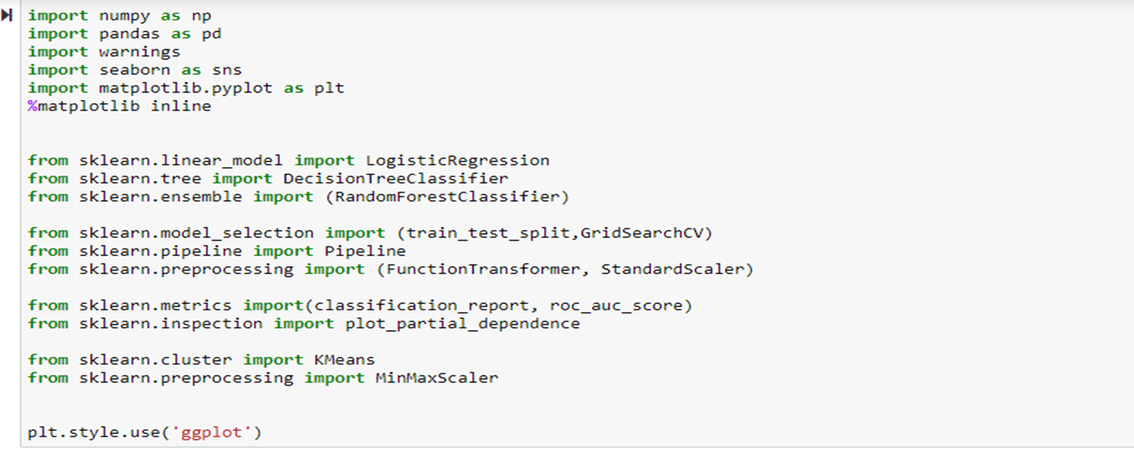
Chapter 2
Data preparation and data exploration

Slide 7
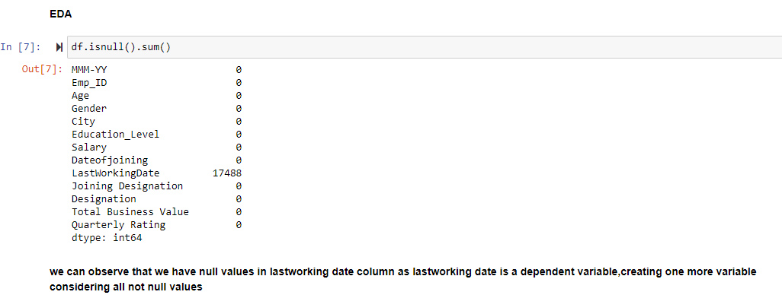
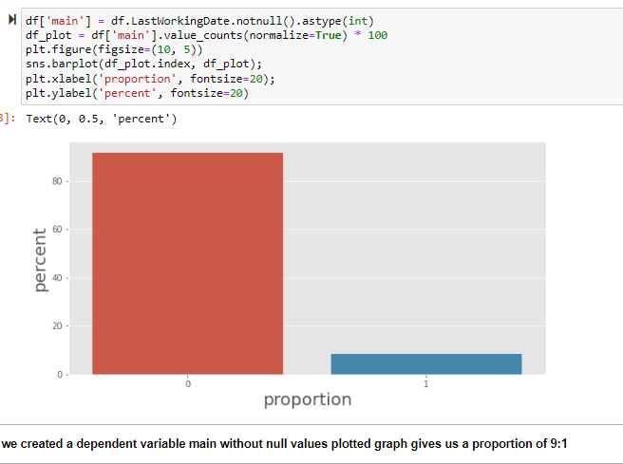
2.2 eda
Exploratory data analysis (EDA) is used to analyze and investigate data sets and summarize their main characteristics, often employing data visualization methods.
created a dependent variable main with last working days values
So that we can use that attribute to compare with others and find what is causing attrition

Slide 8
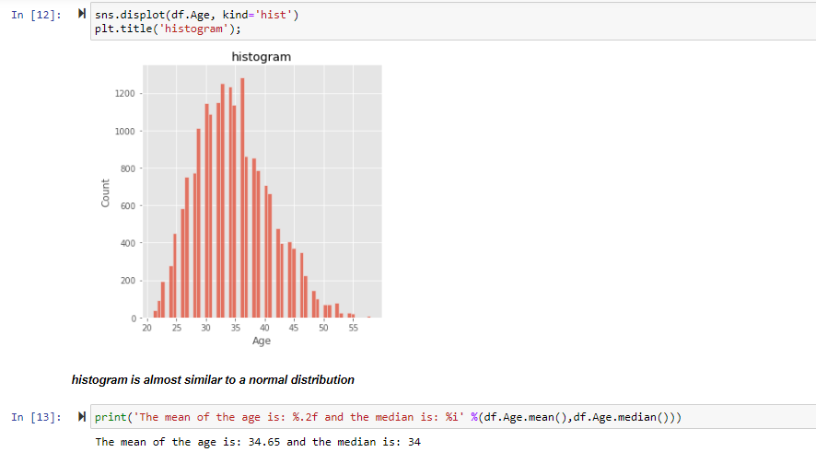
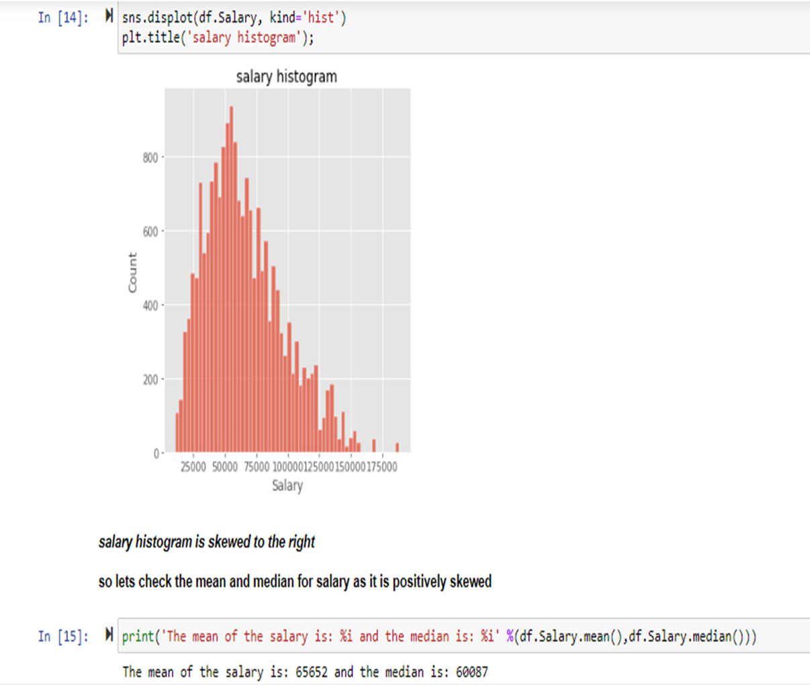
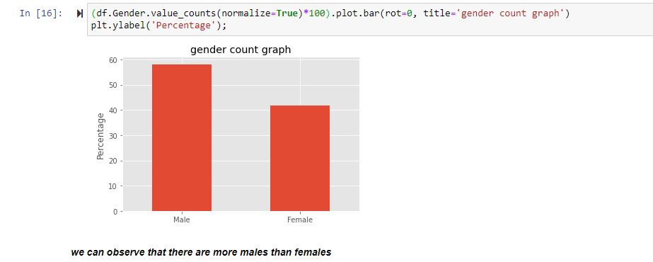
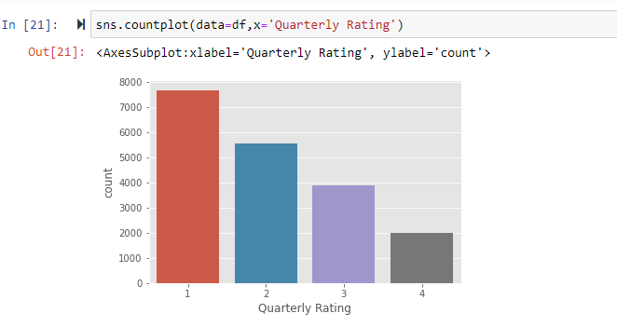
2.3 visualization(eda) (observations and results)
Here we can observe that the salary histogram is skewed to the right i.e. it is a positive mean distribution where the mean median and the mode are positive. The difference between the mean and the median is 5000USD. In the gender graph there is almost a difference of 16% and we can see a decrease in the quarterly ratings

Slide 9
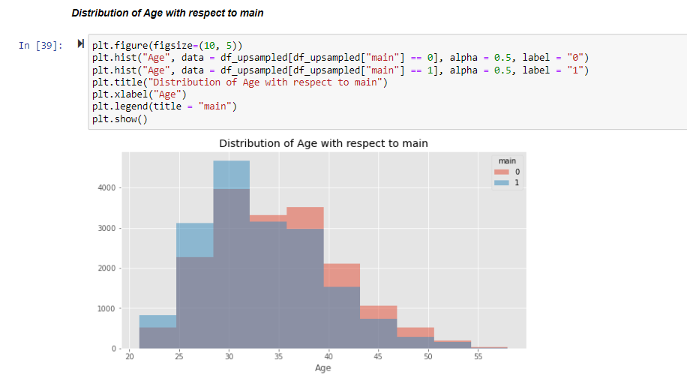
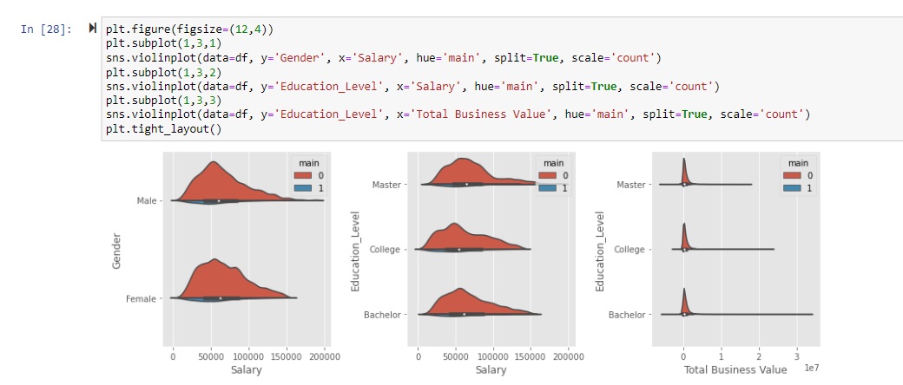
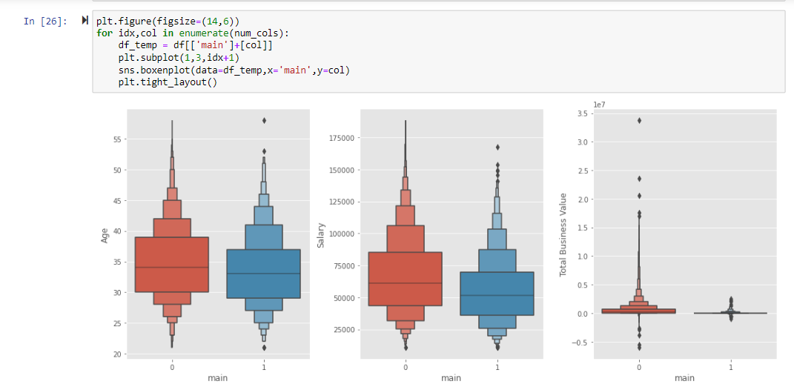
Plotting variables with the main variable
For the total business value, we see a lot of outliers and We can observe that young employees have a little more chance to quit their job and low salary could be one of the reasons. Next We have plotted our graphs in such a way that we have compared them with our main value and the proportions of the positive case are low, we cannot see a great difference. An important observation is that the employees who did master’s degrees have more salary. People with lesser salary are quitting the job.
And also we can observe that young people are quitting more than the elder ones.

Slide 10

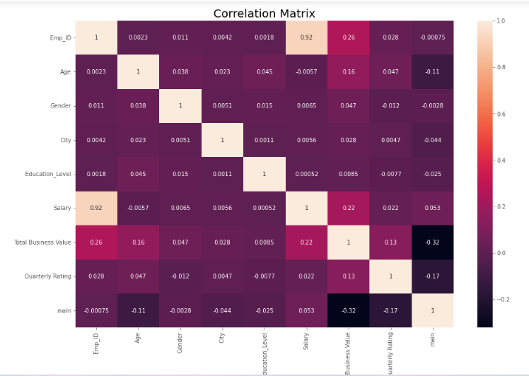
Chapter-3 DATA PREPROCESSING
The correlation matrix
Data processing is the task of synchronizing data from various sources.
Steps involved-
Taking care of missing data and dropping non-relevant features
Feature extraction
Converting categorical features into numeric form binarization of the converted categorical features
Understanding correlation

Slide 11

Chapter-4 model building and testing
Model building-
The process of modeling means training a machine learning algorithm to predict the labels from the features, tuning it for the business need, and validating it on holdout data.
Models used for employee attrition:
Logistic regression
Random forest
K-nearest neighbors classifier
Gaussian naïve bayes classifier
Decision tree
For all the models its accuracy ,f1 score ,roc-auc and confusion matrix is done for all the classifiers

Slide 12
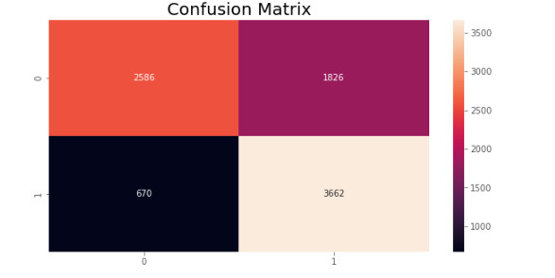
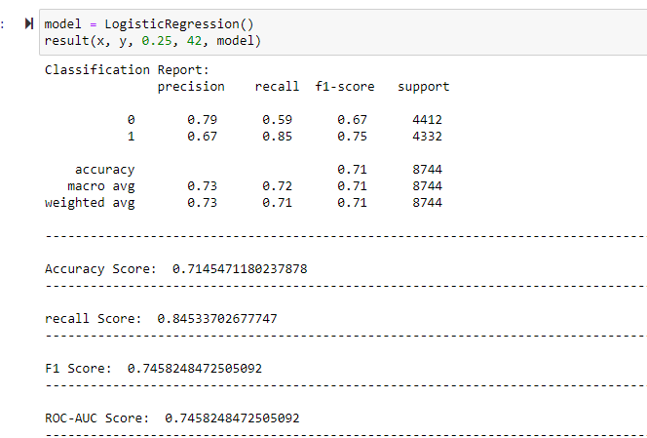
4.1 logistic regression
Logistic regression is one of the most basic and widely used machine learning algorithms for solving a classification problem
It is a method used to predict a dependent variable.
the harmonic mean of precision and recall ie f1 score for logistic regression is 0.7458
accuracy score for this model is 0.714
Roc-auc a better job of classifying the positive class in the dataset.

Slide 13
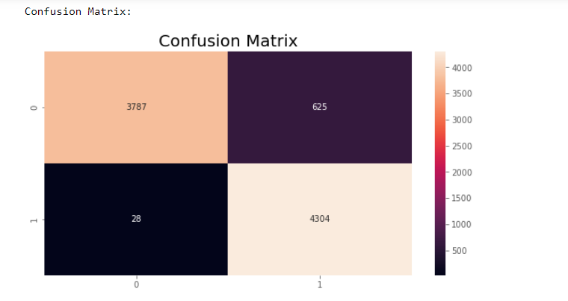
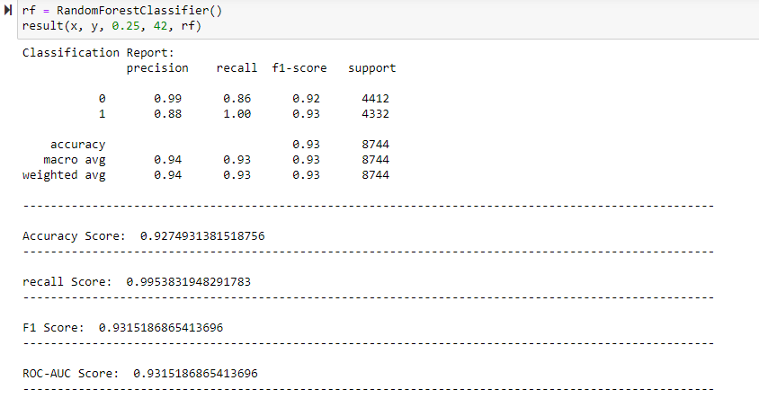
4.2 random forest
Random forest is a supervised learning algorithm
It creates a forest and makes it randomly based
on the bagging technique. It aggregates classification trees
In a random forest, only a random subset of
the feature is taken into consideration by that algorithm
for random forest classifier Accuracy Score: 0.926 F1 Score: 0.93

Slide 14
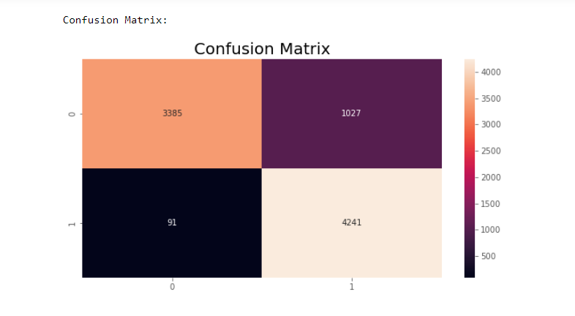
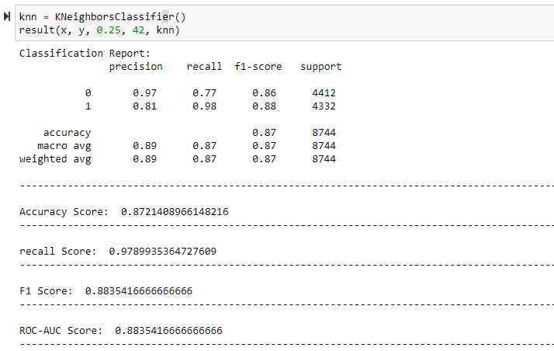
4.3 K-Nearest Neighbor Classifier K-nn algorithm assumes the similarity between the new case/data and available cases and put the new case into the category that is most similar to the available categories. K-nn classifier has an accuracy of 0.87 and f1 score is 0.88.

Slide 15
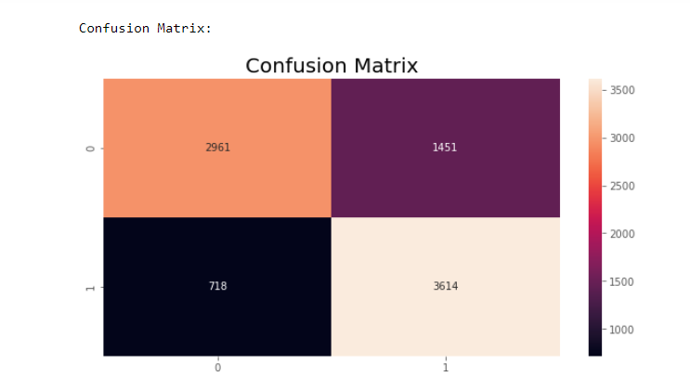
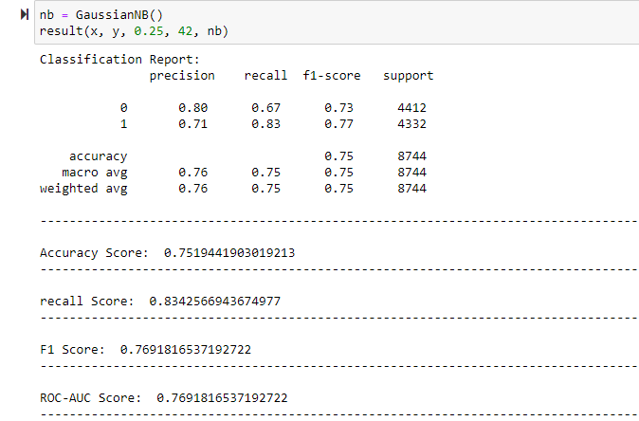
4.4 gaussian naïve Bayes Gaussian naive Bayes is a probabilistic classification algorithm based on applying Bayes' theorem with strong independence assumptions Gaussian naive Bayes model has an accuracy score: 0.75 and f1 score: 0.76

Slide 16
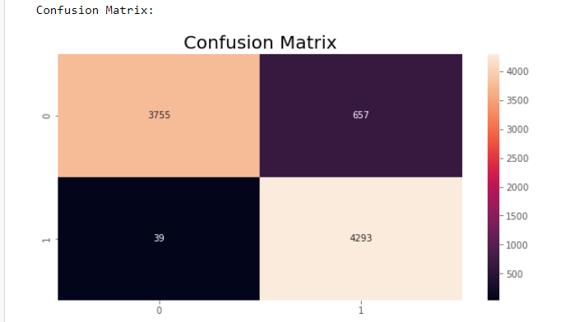
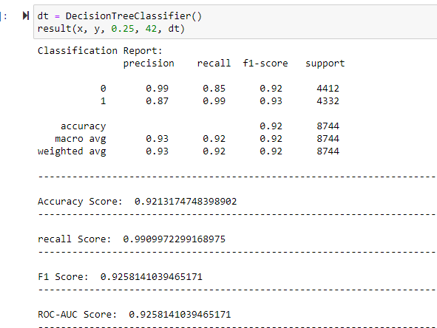
4.5 decision tree classifier Decision trees are a type of supervised machine learning where the data is continuously split according to a certain parameter. that is you explain what the input is and what the corresponding output is in the training data. This model has an accuracy score: 0.92 and f1 score: 0.925

Slide 17
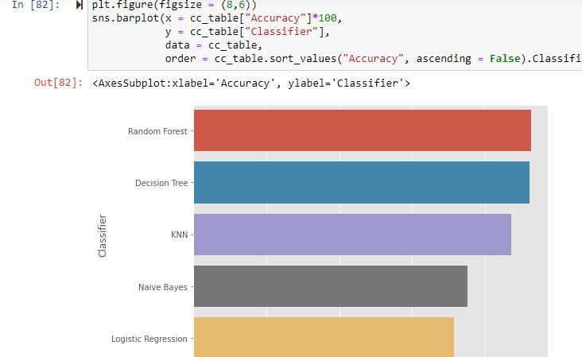
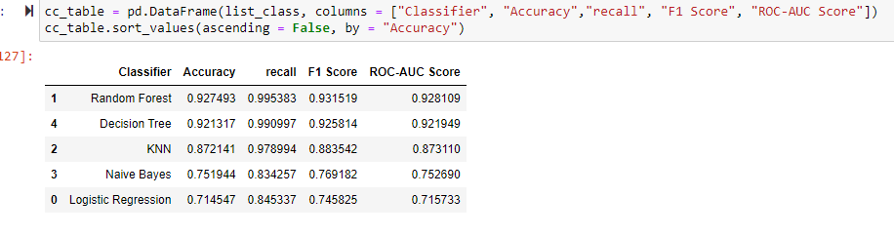
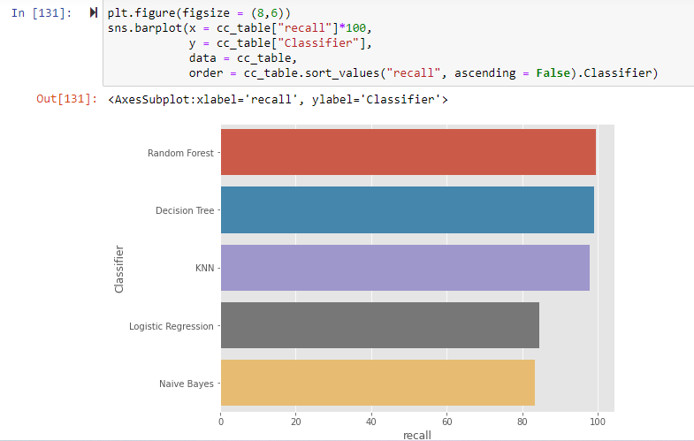
Chapter-6 comparison of models
Plotting the Comparison Table as a Bar Plot For Accuracy
For recall Score

Slide 18
Conclusion
we have found that the employees are resigning mainly of the less pay and also mostly, employees who leave tend to be young, with less t working period. from graphical representations, we have found that people with master’s degree have higher pay. After training and testing 5 models against our dataset and comparing the evaluation metrics of each model we can conclude that the best classifier for our dataset is random forest and decision tree classifier would be the next best option.

